Slide 1

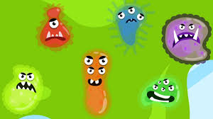
CELL BIOLOGY
AS PER The Ontario Curriculum,
Grades 1–8: Science and Technology
Prepared by professor B. Kriger

Slide 2
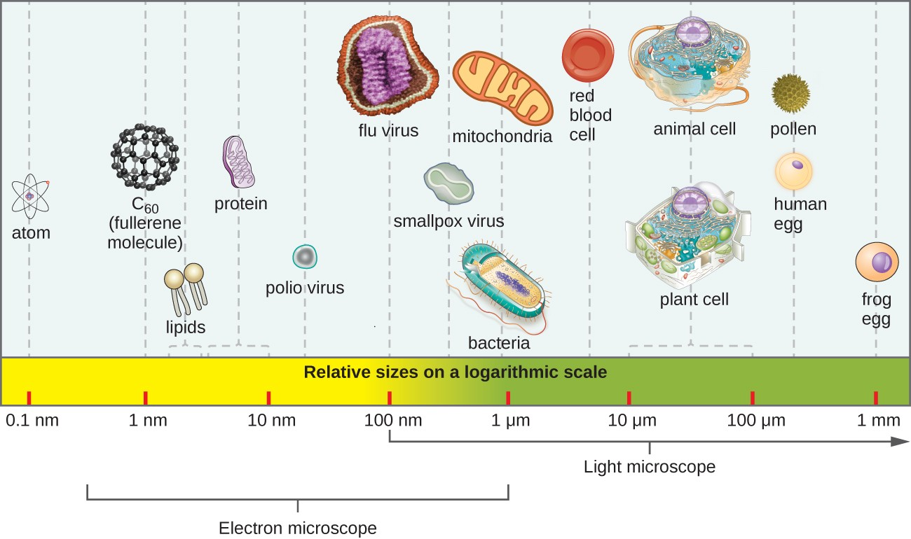

Slide 3
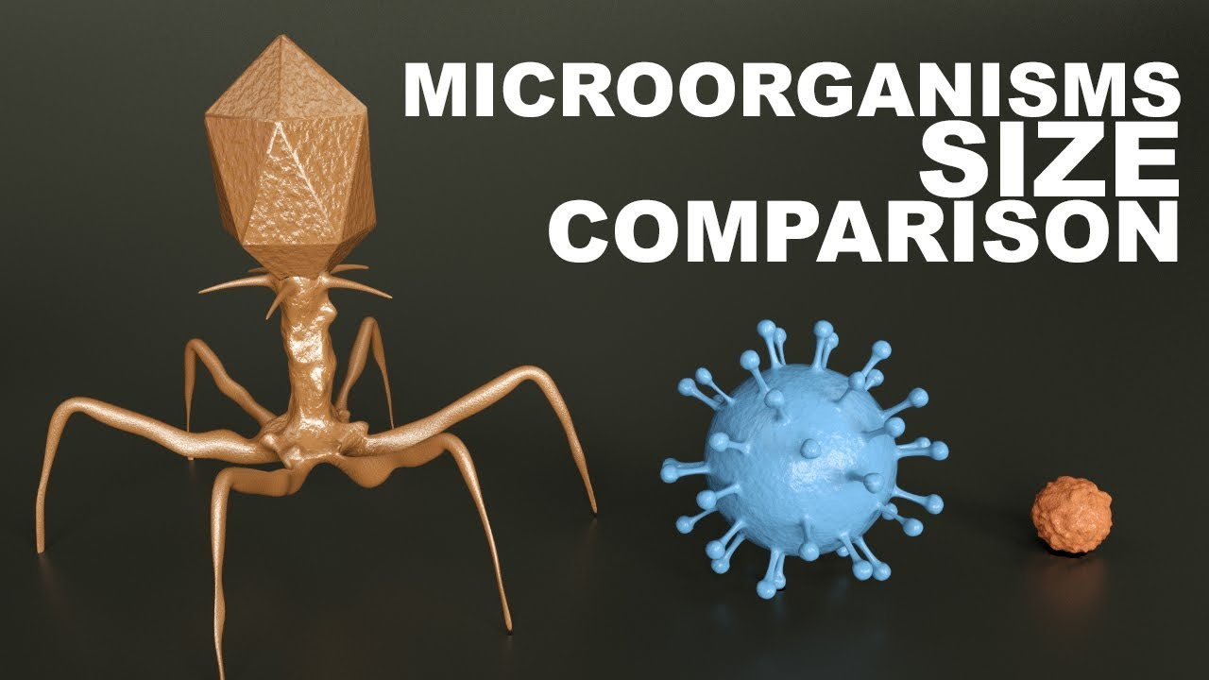
Microorganisms Size Comparison
https://youtu.be/h0xTKxbIElU

Slide 4
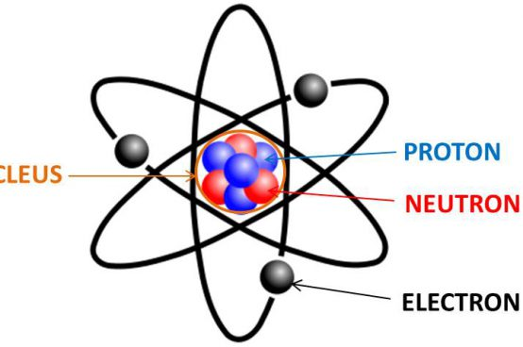

SIMPLIFIED ATOM STRUCTURE

Slide 5
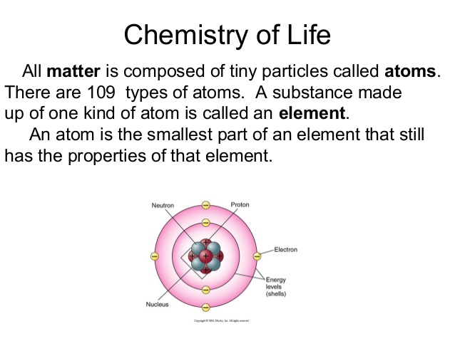
SIMPLIFIED ATOM STRUCTURE

Slide 6
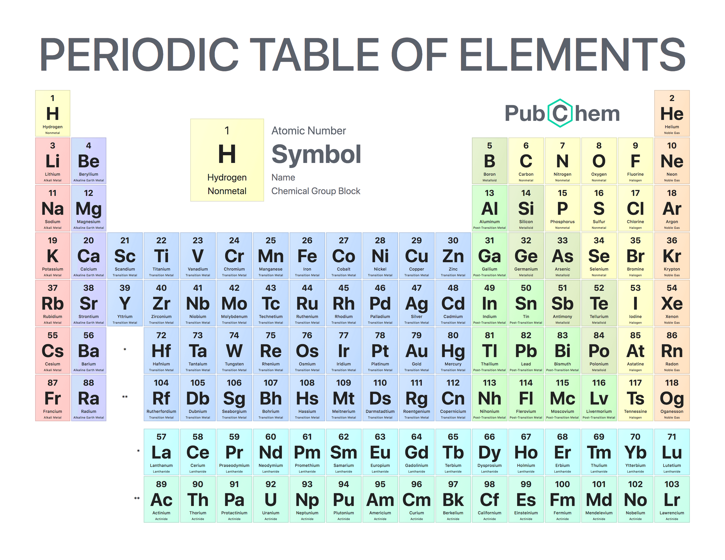

Slide 7
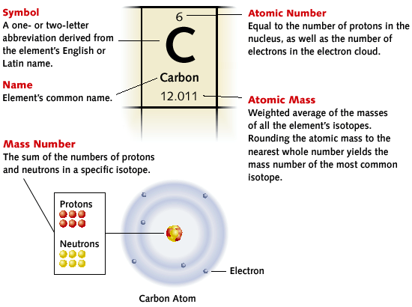

Slide 8
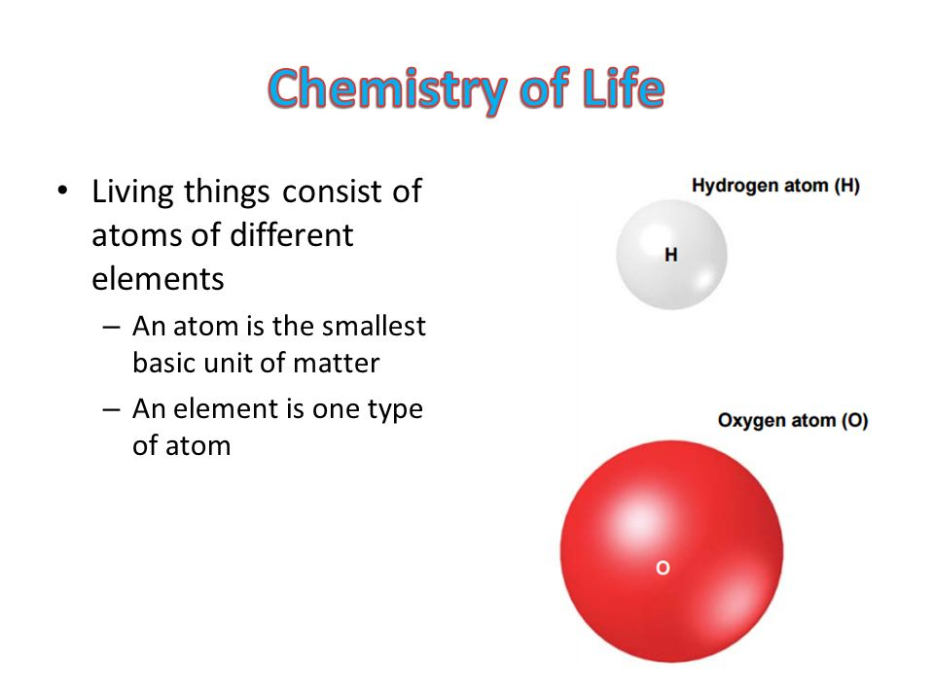
SIMPLIFIED ATOM STRUCTURE

Slide 9
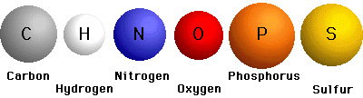
ATOMS OF LIFE

Slide 10

CHEMICAL BOND

Slide 11
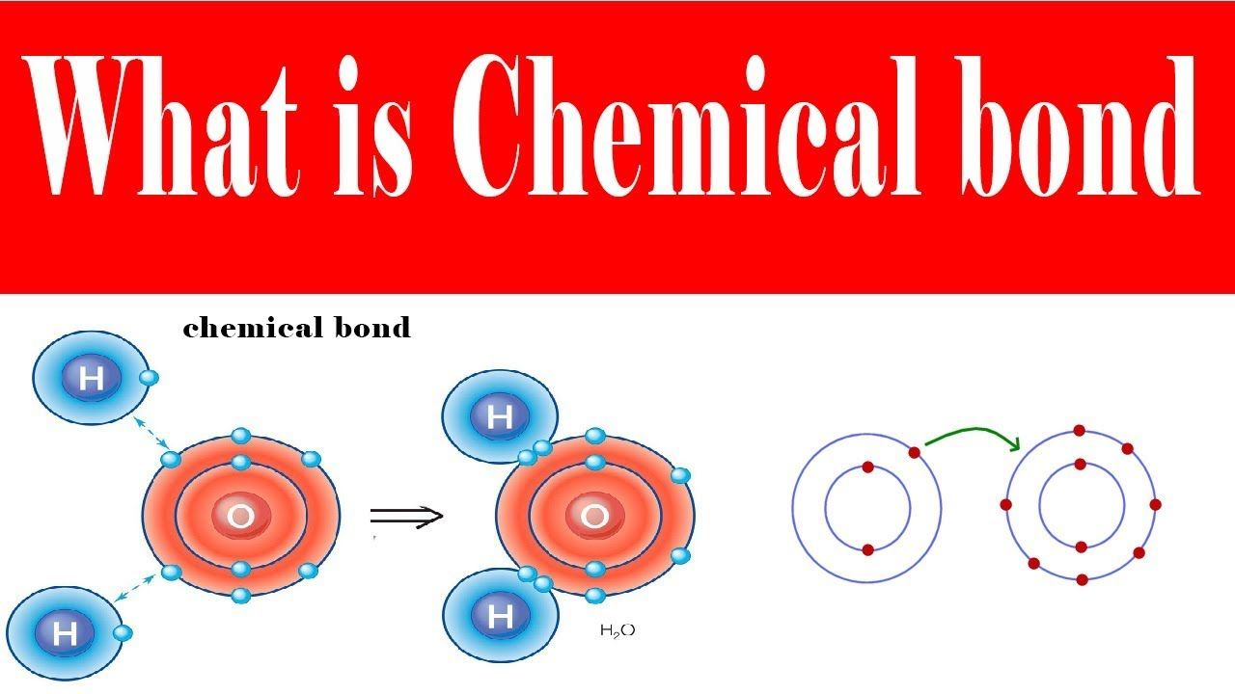
CHEMICAL BOND

Slide 12
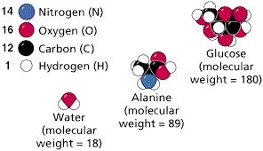
BUIDING THE MOLECULES

Slide 13
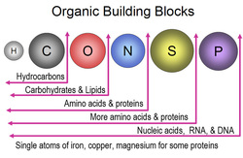
ATOMS OF LIFE

Slide 14
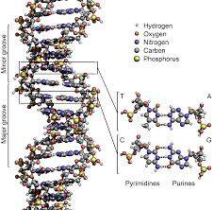
DNA

Slide 15
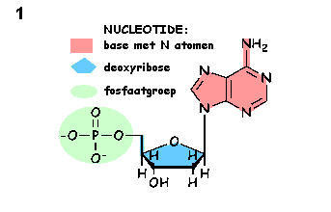
DNA

Slide 16
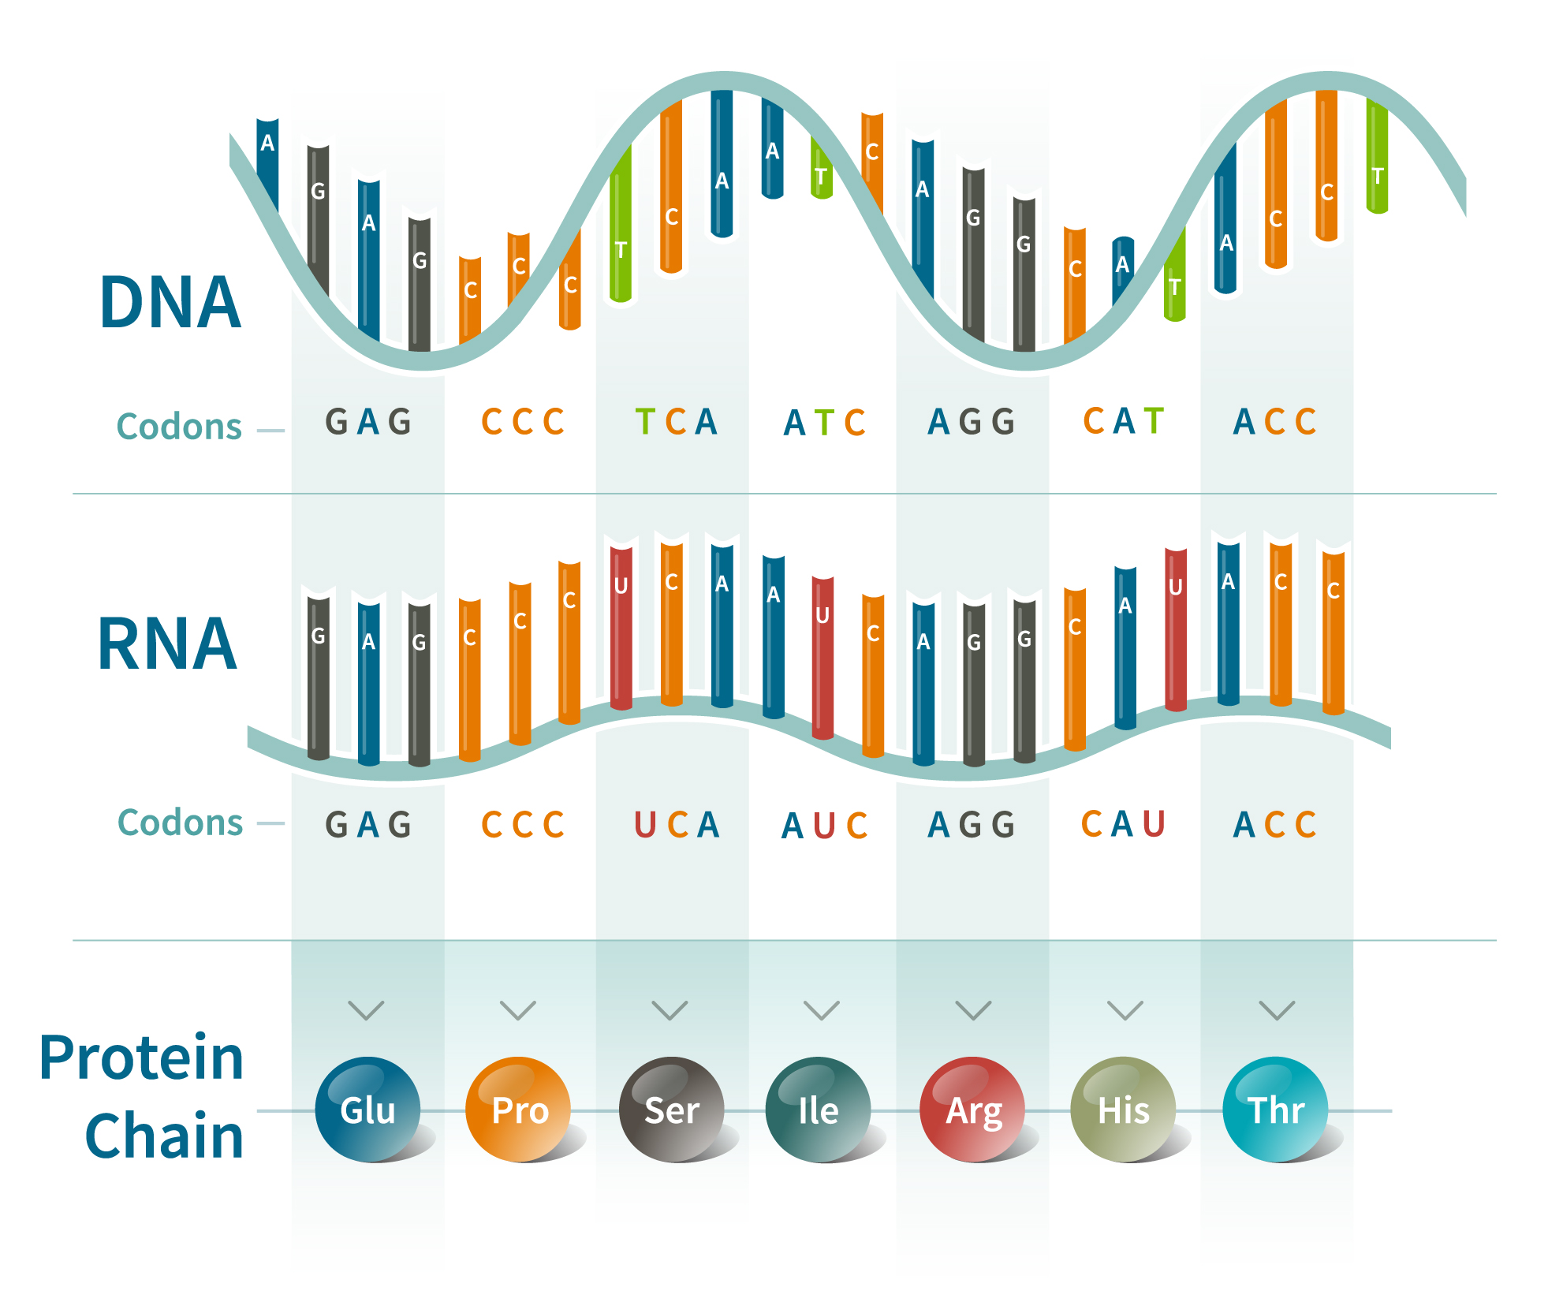
DNA

Slide 17
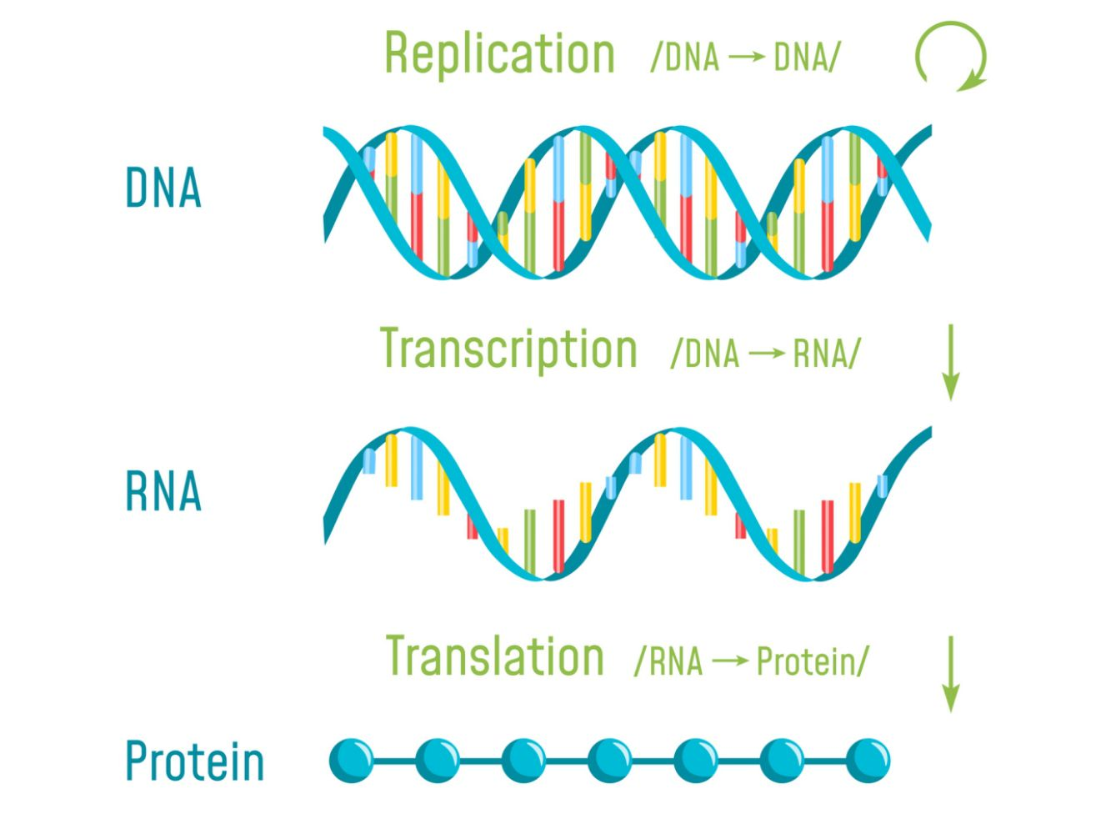
MICRO ORGANIZMS
They use others to make their lives better.

Slide 18
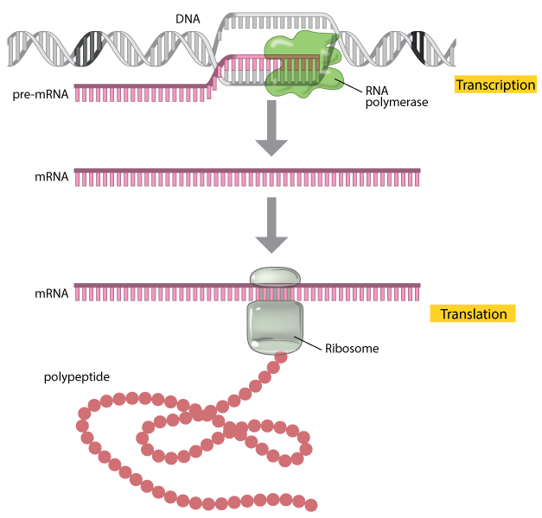
MICRO ORGANIZMS
They use others to make their lives better.

Slide 19
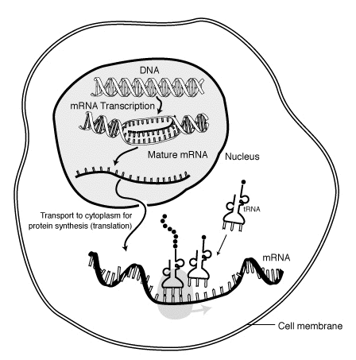
MICRO ORGANIZMS
They use others to make their lives better.

Slide 20
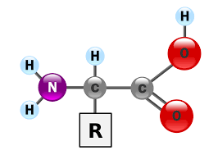
AMINO ACID

Slide 21
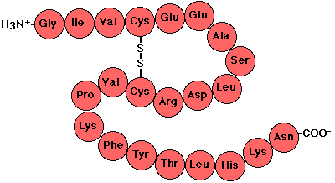
PROTEIN - POLYPEPTIDE
They use others to make their lives better.

Slide 22
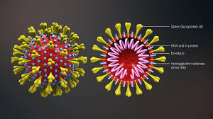
VIRUS – COVID-19
They use others to make their lives better.

Slide 23
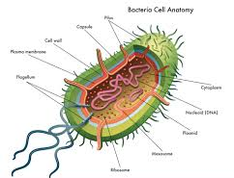
BACTERIA CELL
their lives better.

Slide 24
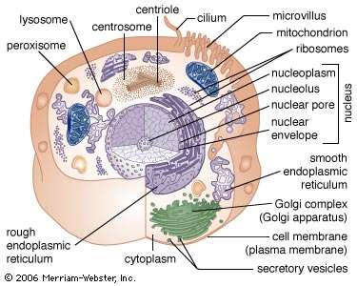
CELL
They use others to better.

Slide 25
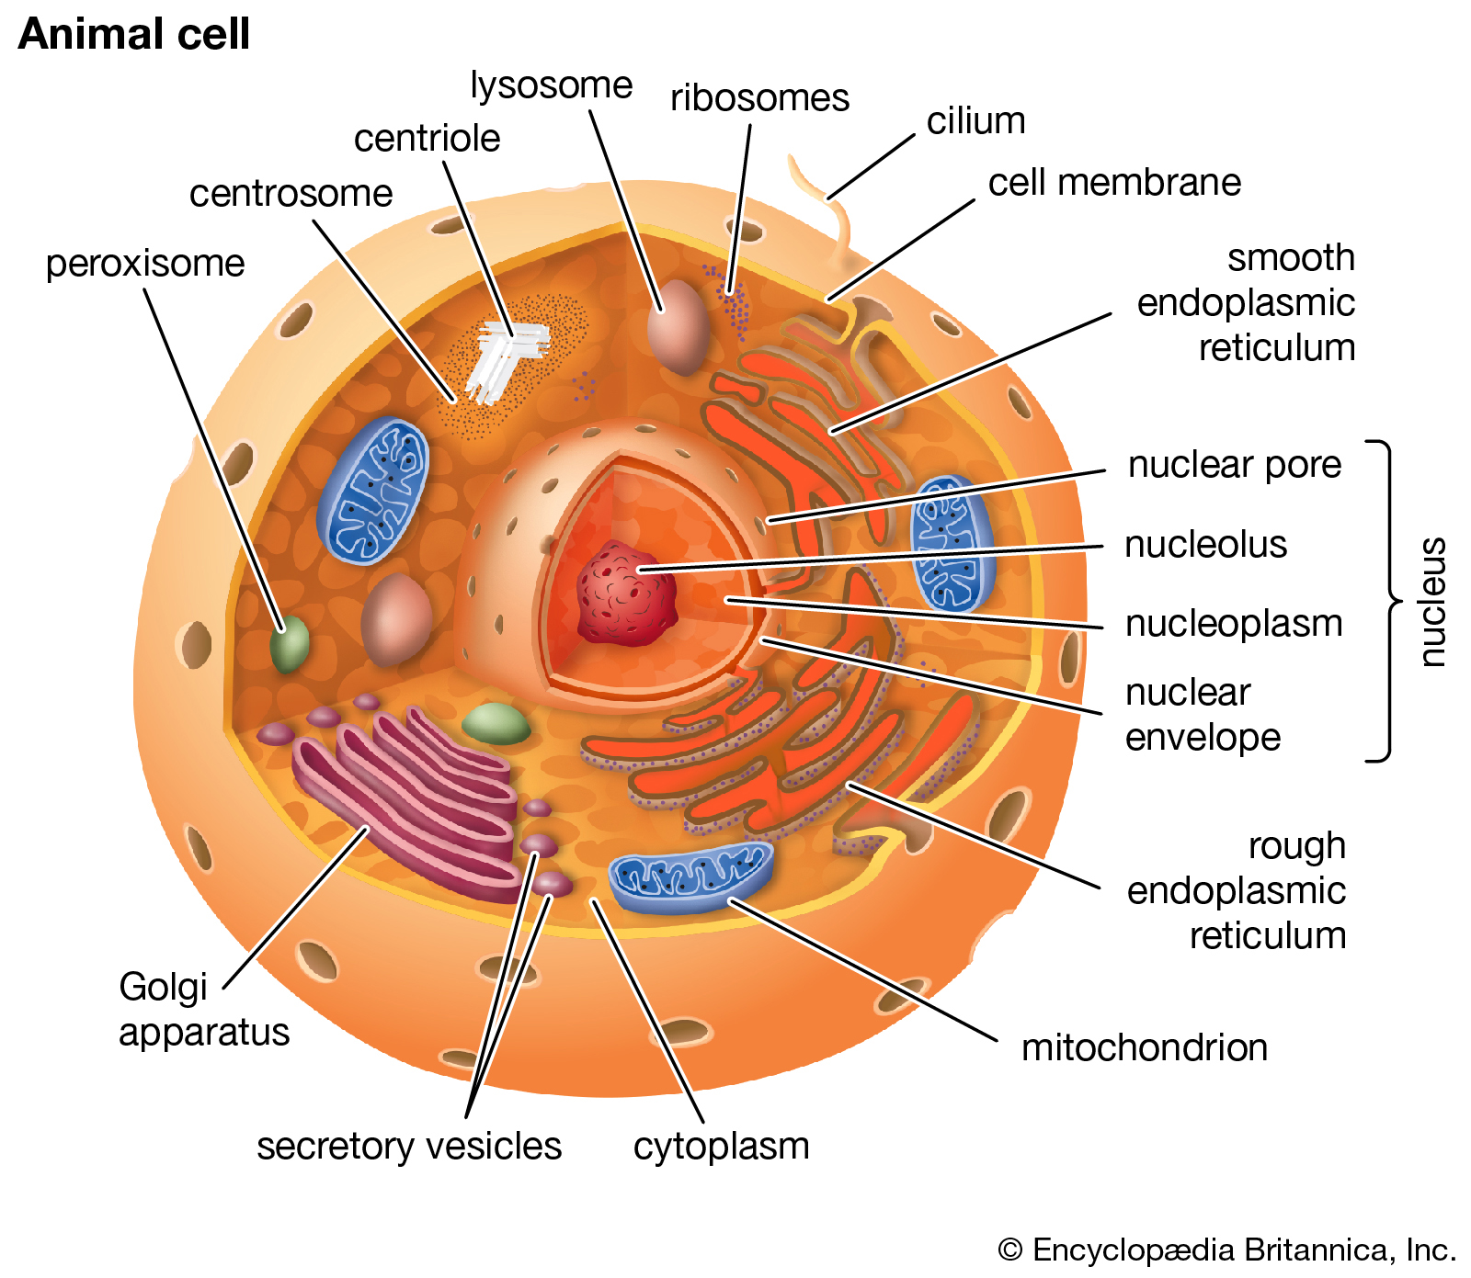
MICRO ORGANIZMS

Slide 26
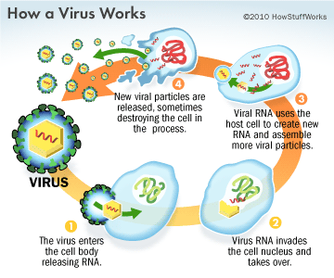
MICRO ORGANIZMS

Slide 27
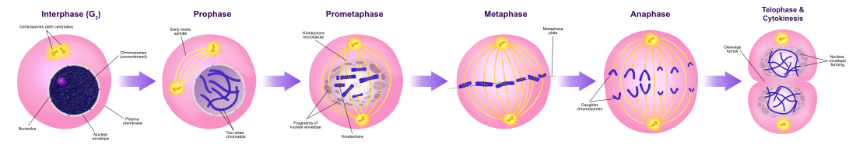
HOW DO THE CELLS DIVIDE?

Slide 28
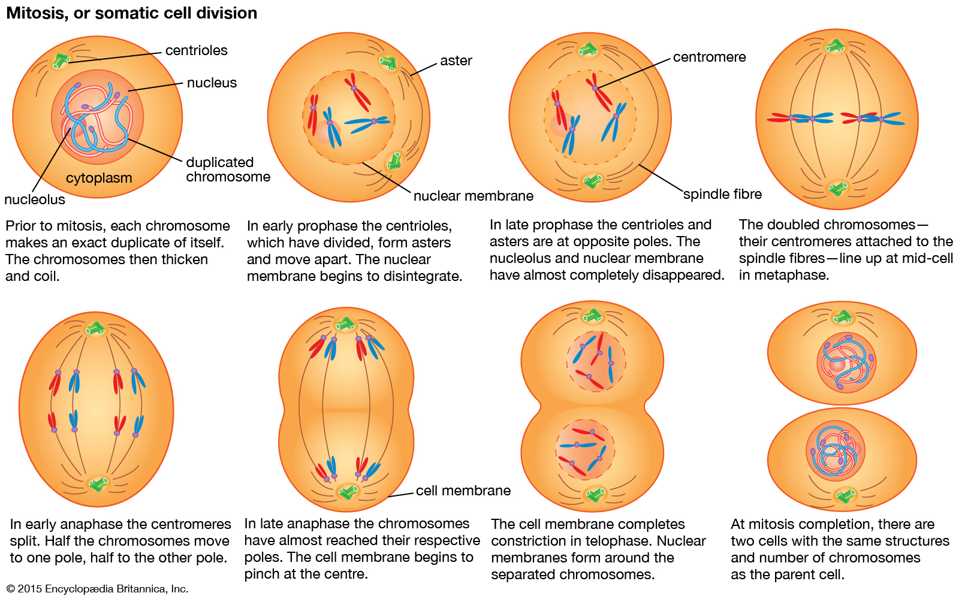
MITOSIS
They use others to make their lives better.

Slide 29
